Slide 1
ESA AO/1-11089/21/NL/FE Fast locking RF connector Interface up to W band Technical Development Programme Final presentation SPCD : 17/10/2024

Slide 2
Table of contents
Introduction
WP1: Space Applications of RF Interconnections Review and Requirements
WP2: RF Interconnection Design Review and Design Trade-off
WP3: Development and Manufacturing of the new RF Interface with fast-locking mechanism
WP4: Characterisation Tests and Optimisation
WP5: Identification of Limitations, Improvements and Impact on Payload Level
Conclusion

Slide 3
Introduction
This study aims to develop the new fast-lock interconnection open-standard which will cover the interconnection needed for the satellite RF system up to the W-band (110 GHz)
Radiall will develop the most relevant fast lock solution , especially adapted for a use in the W-band.
AXON will design a robust cable with optimized performances up to W-Band
AXON and RADIALL will collaborate to develop and optimize the cable assembly
AXON will perform the cable assembly evaluation while Radiall will evaluate the connector itself
Duration of the project: 24 months
TARGET : up toTRL4 => proof of concept technology

Slide 4
WP1 : End-User feedback and Review of Existing solutions

Slide 5
WP1 : End-User feedback and Review of Existing solutions
Topic | Status | Synthesis
End Users market survey | Only 2 feedback forms - TESAT - Nihon Maruko | No real demand for the moment : - Client Specifications can’t be determined yet. - Need anticipated in 5 years
Existing W-Band Coaxial Assemblies | Number of Manufacturers - America : 5 - Asia : 7 - Europe : 1 | Medium and high quality products - Coax Assemblies dedicated for lab Measurement - No existing solution for Space Applications

Slide 6
WP2: RF Interconnection Design Review and Design Trade-off

Slide 7
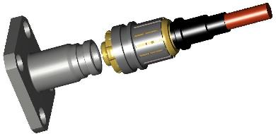
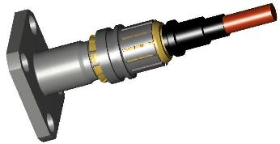
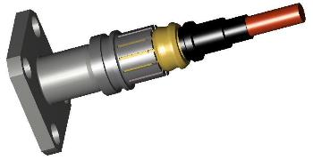
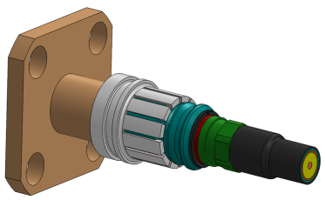
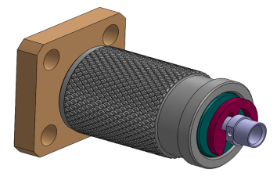
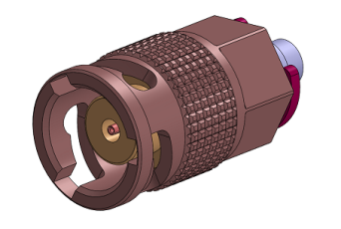
WP 2 : Choice of the fast lock system
“2 steps Push and lock“
Concept used on SMP Lock and SMPM lock
“1 step Push and lock”
Concept used on NEX10 type
Bayonet system, used on BNC type
“Push and twist“

Slide 8
WP2 : Choice of the fast lock system
Push and Twist
Push lock
Push then lock
Size/Compacity
Locking simplicity
Unlocking simplicty
Mechanical strenght
Quantity of specific components
Manufacturability
Impact on Cable

Slide 9
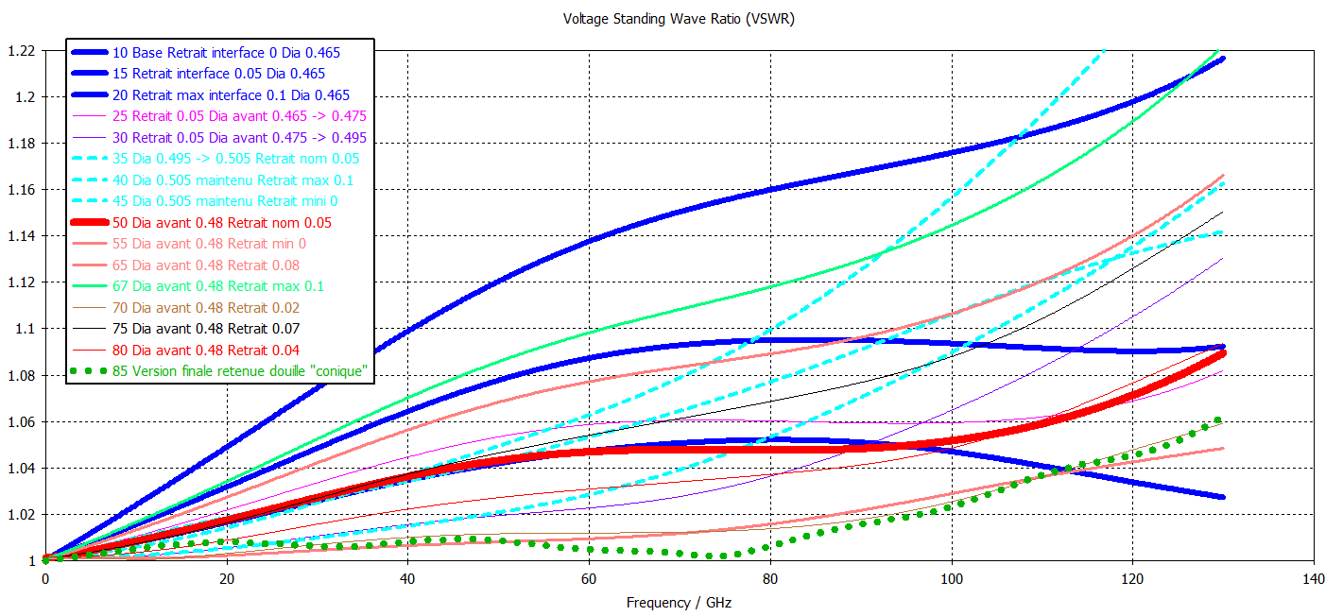
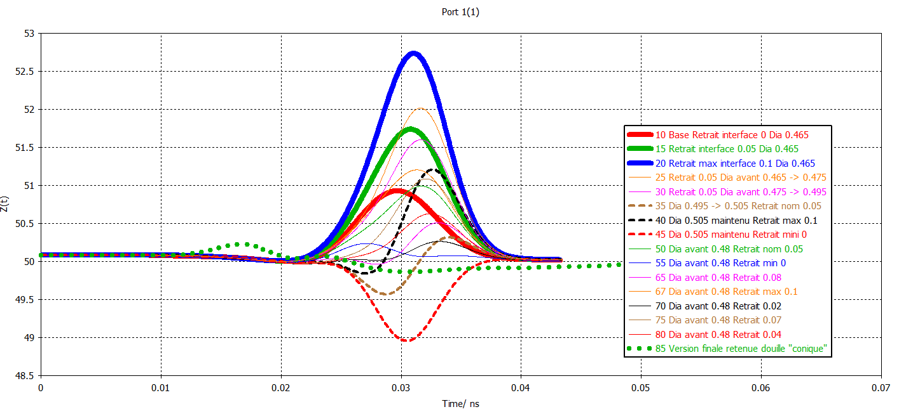
WP 2 : Interface 1 mm, 110 GHz RF line
Step 1 : define the 1 mm RF line and interconnection between the pin and the socket
Step 2 : define the captivation of the center contact (dielectric = air)
1 mm

Slide 10
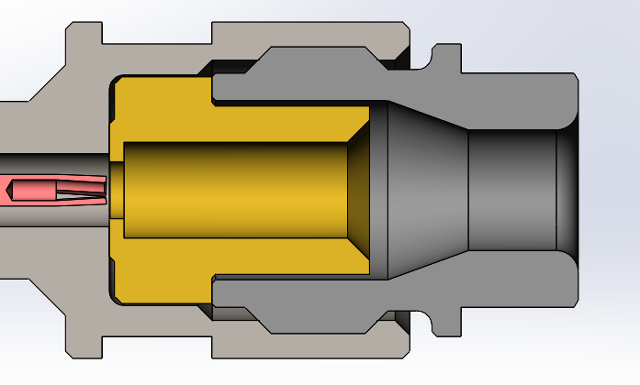
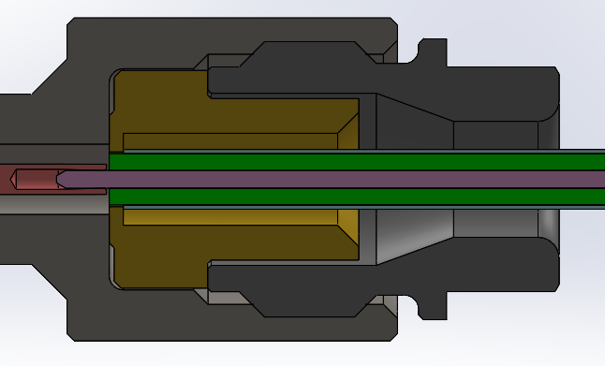
WP2: CONNECTION ON CABLE
The cable core, whose end has been prepared beforehand (AXON procedure), is held coaxial to the ferrule diameter during soldering. Precisely fitted into the body, the cable core is consequently the central contact of the connector and is thus held coaxially to the body.
Ferrule
Cable core
Soldering area

Slide 11
Cable construction
SX15SP construction (1.5 mm 6.5 g/m) :
1st Shield
SPC tape
2nd Shield
SPC braid
Conductor
SPC Alloy
Dielectric
PTFE
Polyimide tape
Jacket
PFA

Slide 12
WP3: Development and Manufacturing of the new RF Interface with fast-locking mechanism

Slide 13
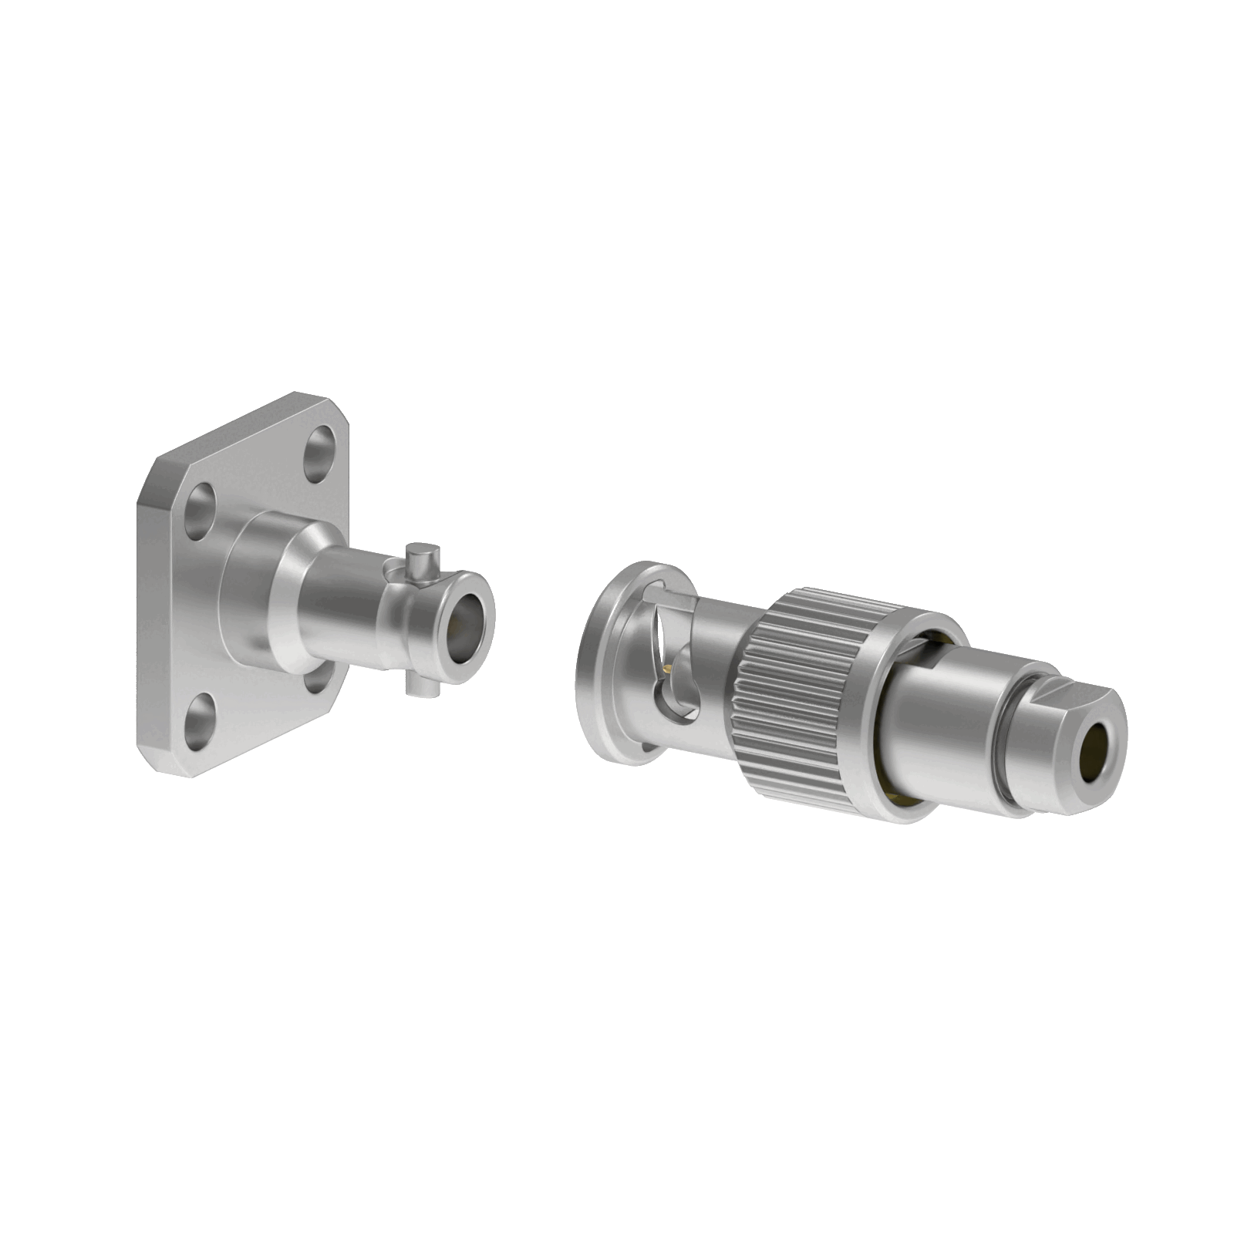
WP3: Fast locking system
Spring system to ensure good pressure between reference planes
Mating done manually
No risk to damage the cable

Slide 14
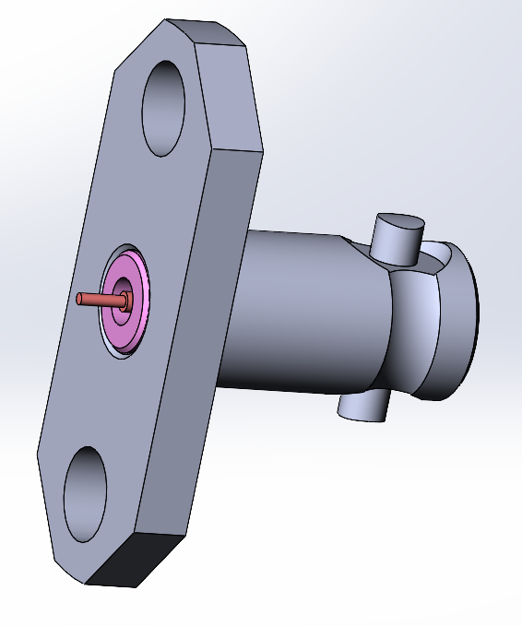
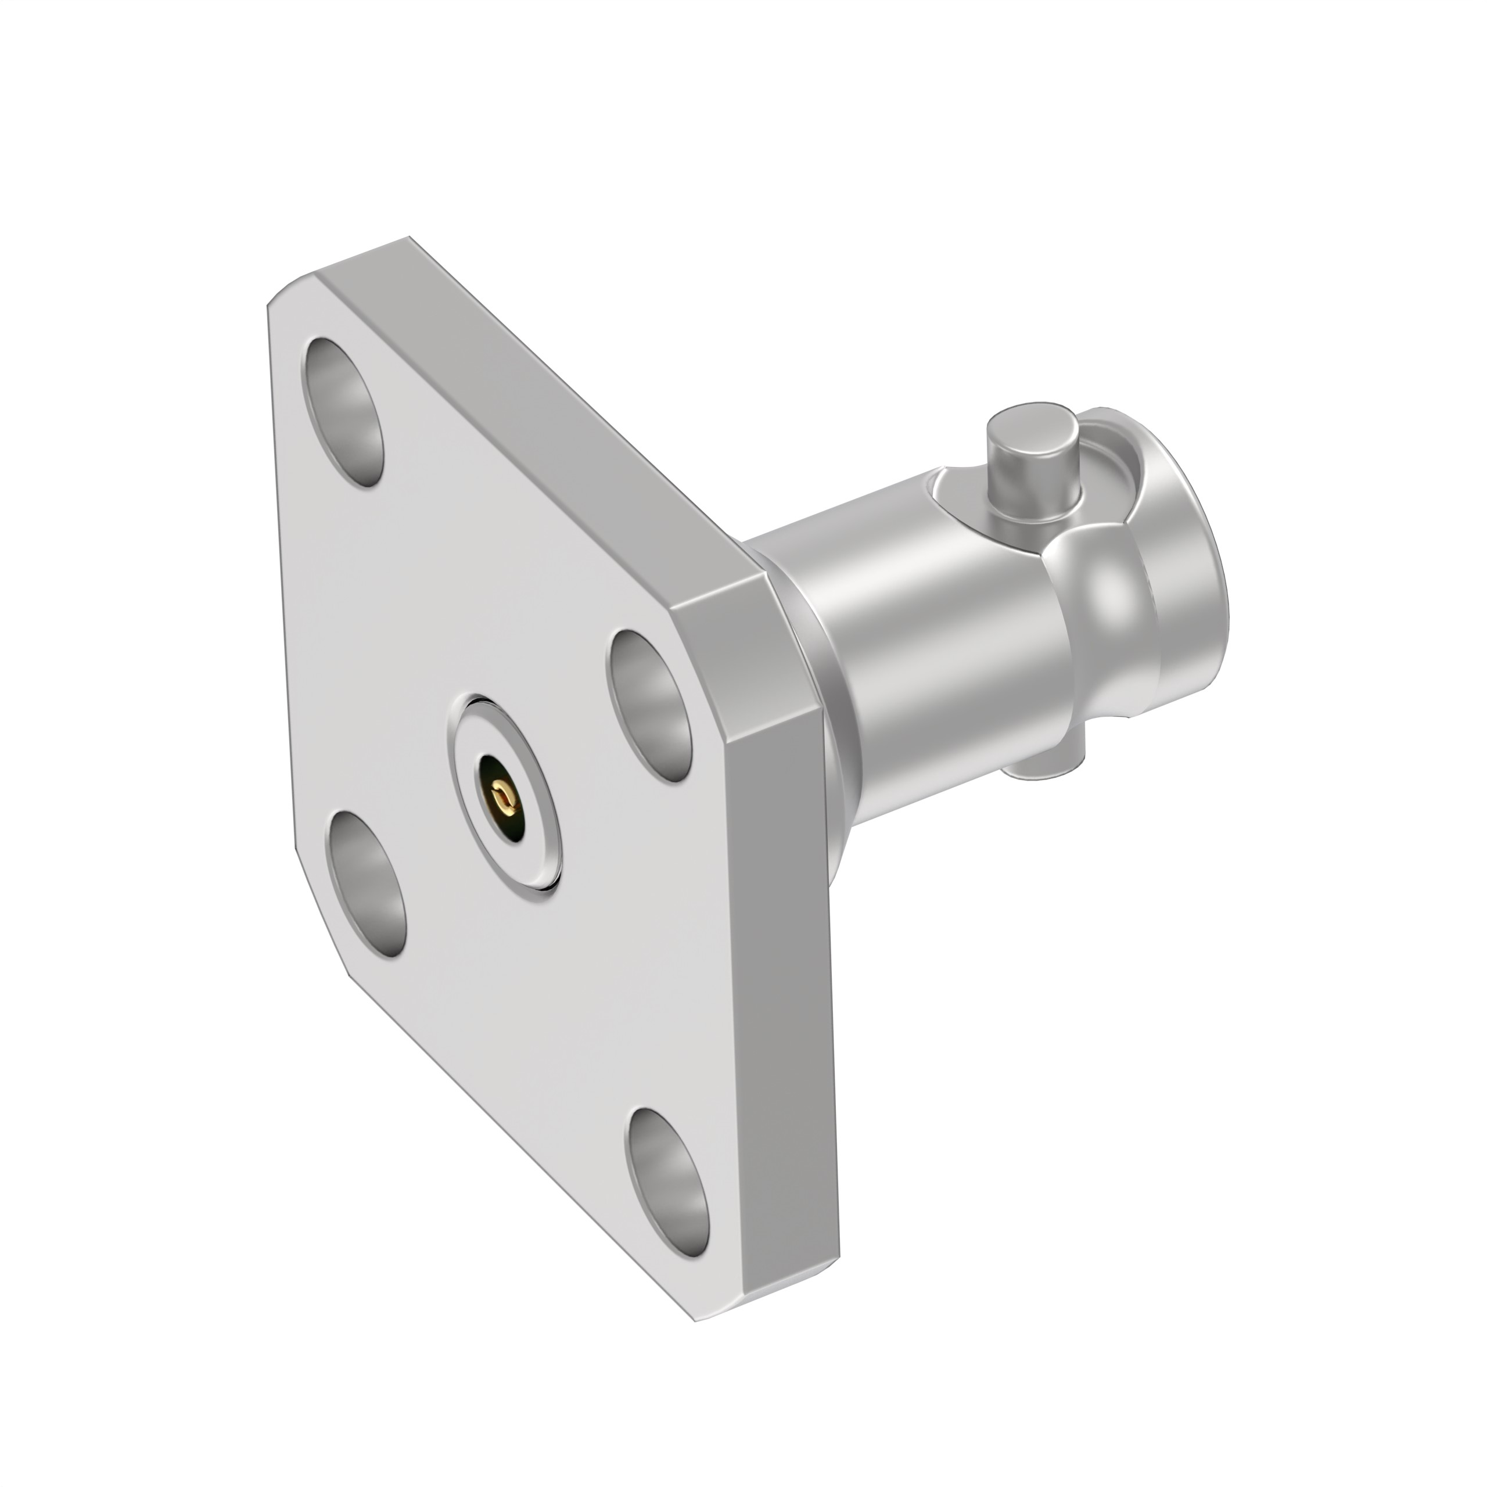
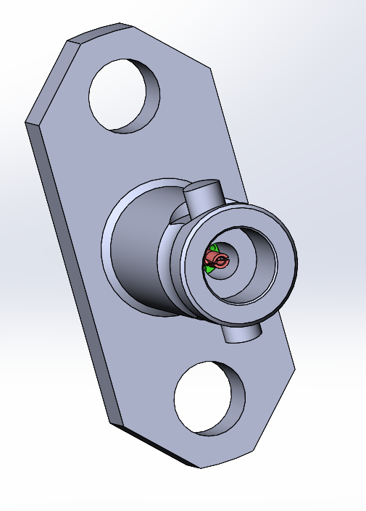
WP3 : Receptacle flange
Truncated flange with cylindrical contact output, diameter 0.25 mm, protruding length 1 mm.
Diameter and length can be modified according to the needs of the PCB.
4 hole flange with socket contact output
Outer contact
Exceeded in relation to the support face.
Socket for pin 0,25mm.

Slide 15
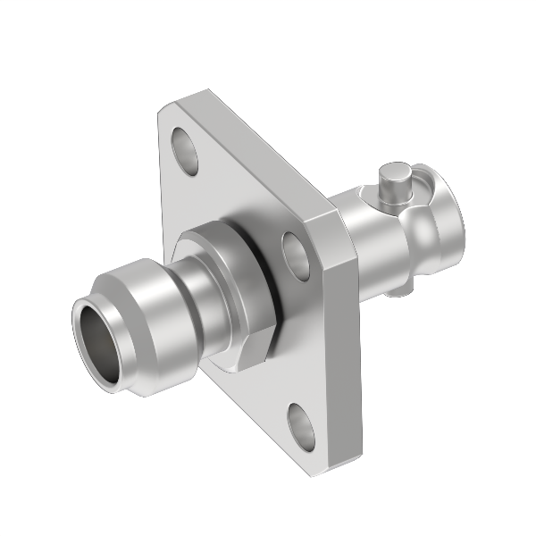
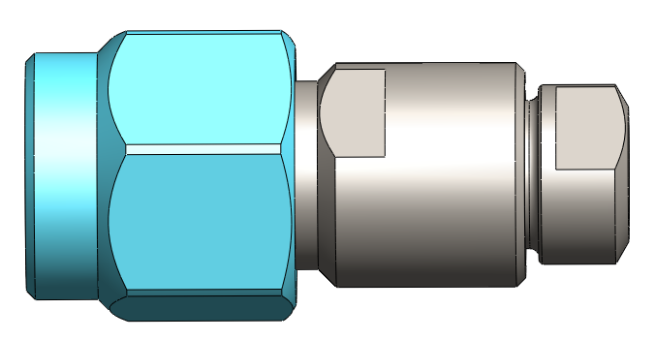
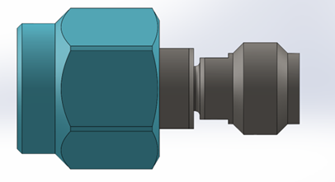
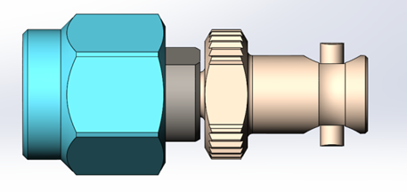
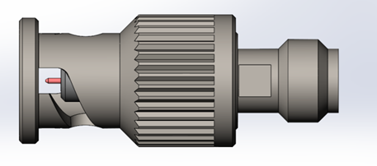
WP3: Precision adaptors IEC 1 mm
Design and manufacturing of a set of adaptors and connectors enable to compare RF performances of fast lock interface and scew-in version (same RF line)

Slide 16
WP4: Characterisation Tests and Optimisation

Slide 17
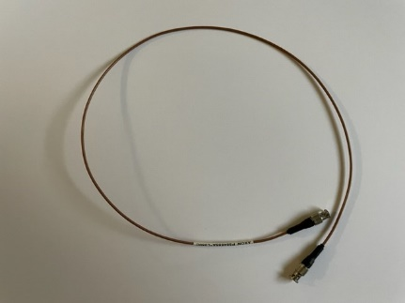
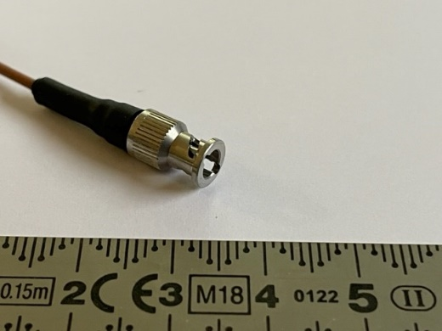
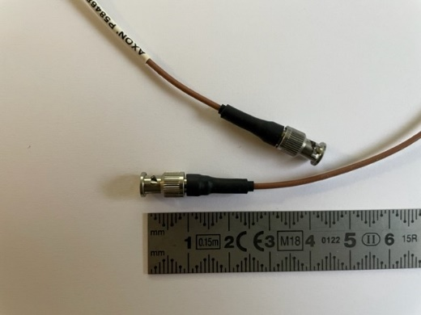
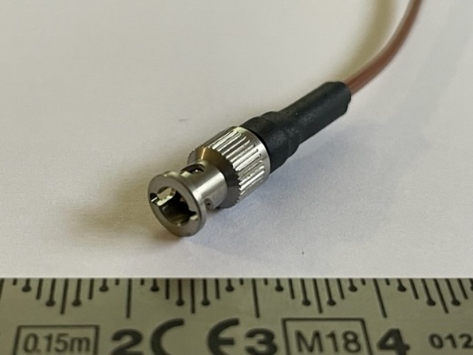
Evaluation Test Plan of W-Band Assemblies with 1mm Fast Lock Connectors
Evaluation based on ESCC2263408, and ESCC3408
Samples are cable assemblies with
Cable Axowave SX15SP
Connector type 1 mm male, Fast-Lock straight
Sample 1m or 0.5m
male connector type 1mm fast lock, straight

Slide 18
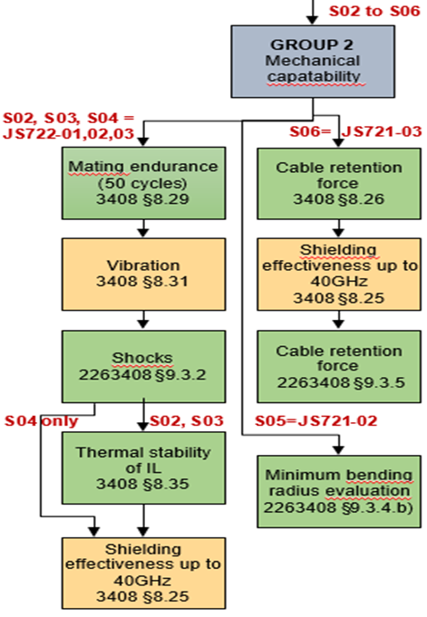
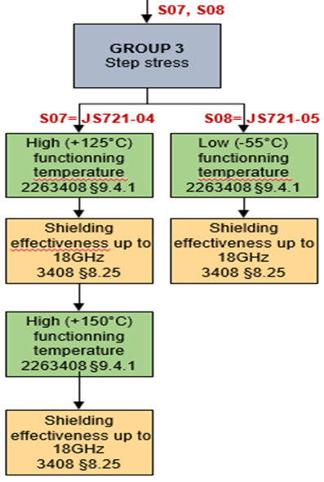
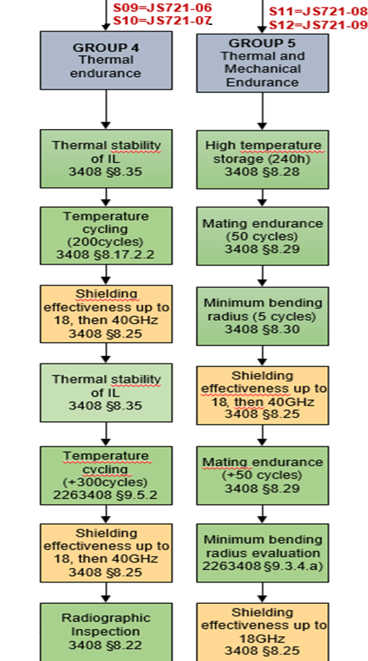
Evaluation Test Plan
2

Slide 19
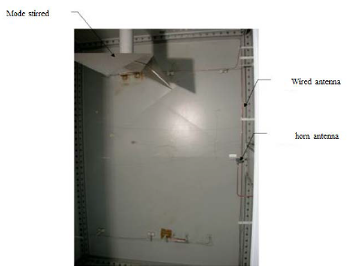
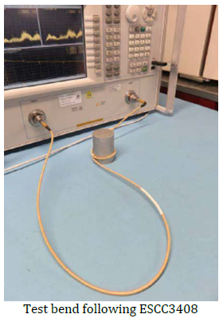
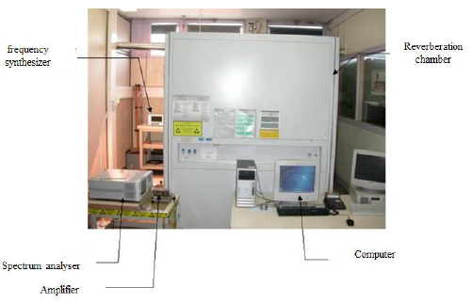
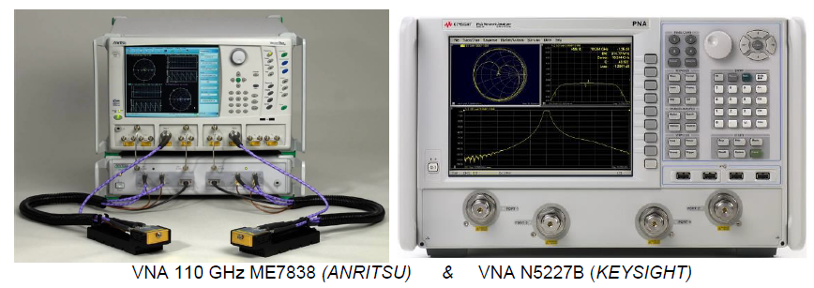
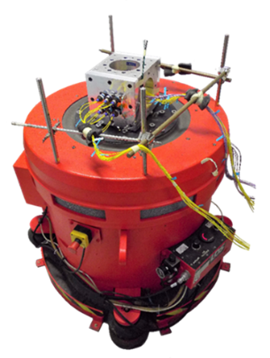
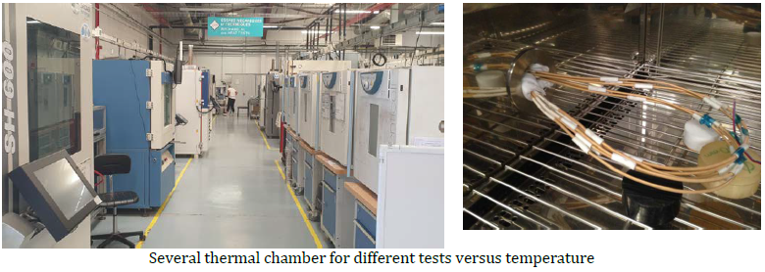
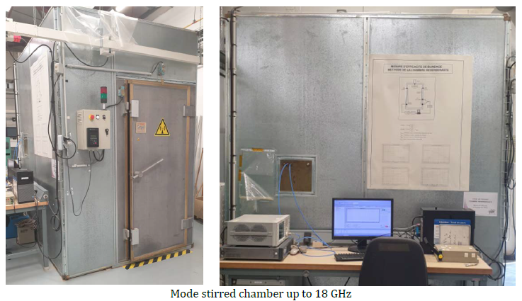
Test facilities
All tests performed at Axon’, except vibrations, shocks and shielding effectiveness measurement up to 40GHz which are done at Radiall
Axon’
Radiall

Slide 20
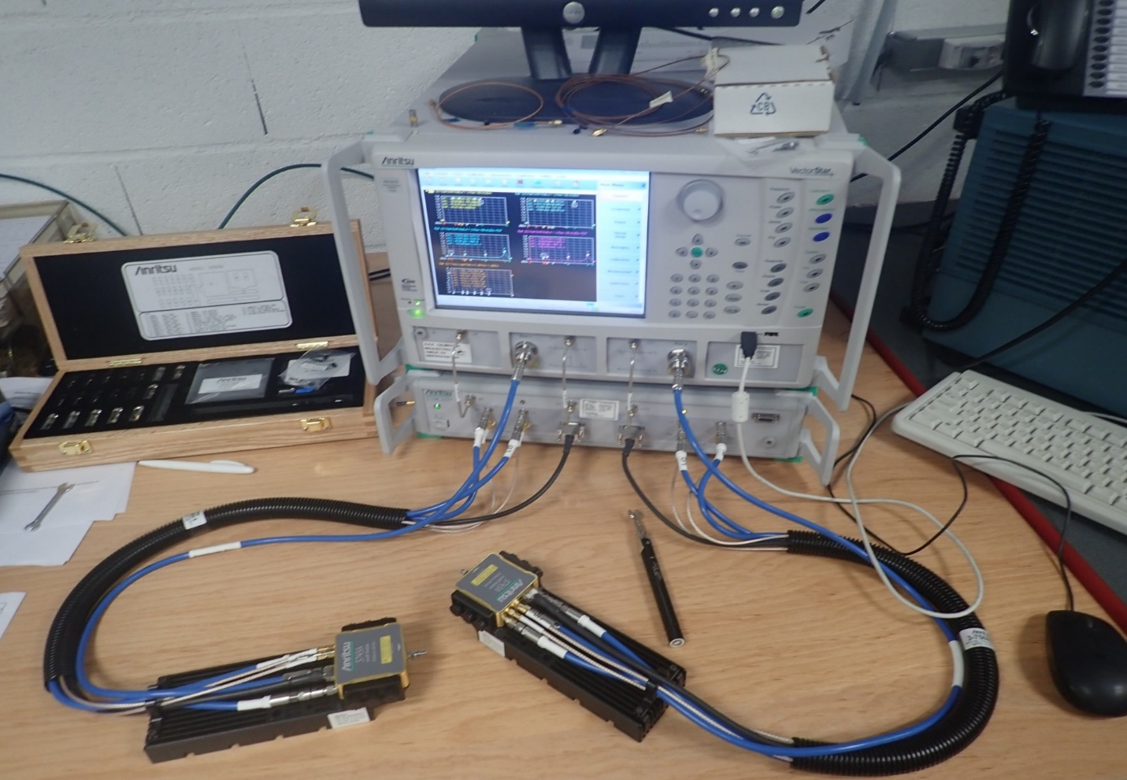
VNA Anritsu
Sij parameter measurements
110 GHz bandwidth
Gating capability

Slide 21
Objectives Achieved
Technical objectives | Targeted Results | Obtained Results
Microwave Performance Bandwidth Return Loss Insertion Loss Shielding effectiveness | Specification DC-110 GHz < -13.98 dB > -23.498 dB at 110 GHz < -50 dB | Best Results DC-110 GHz -17.90 dB -19.93 dB -35 dB | Worst Results DC-110 GHz -14.94 dB -21.99 dB -19.07 dB
Vibrations / Shocks | Sine Vibration : 30G (5-200 Hz) | Success Note : Additional Supports Required
 | Random Vibrations : 38.5G rms 20 to 2000 Hz | Success : No Discontinuity
 | Mechanical shocks : 100 Hz 40G 1000 Hz 900G 4000 Hz 4200G 10000 Hz 4200G | Success : No Discontinuity

Slide 22
Objectives Achieved
Technical objectives | Targeted Results | Obtained Results
Thermal Stability of Insertion Losses (IL) | IL variation < 0.2 dB/s | Success : max 0.18 db/s
Step Stress/ Operating temperatures | -55; 125°C targeting 150°C | Success : -55 ; 150°C
Minimum bending radius + cold bend | Minimum radius 10mm targeting 5mm | Success : 5mm
mating endurance (end of project) | +50 cycles targeting +100 | Success : +100 No considerable damage

Slide 23
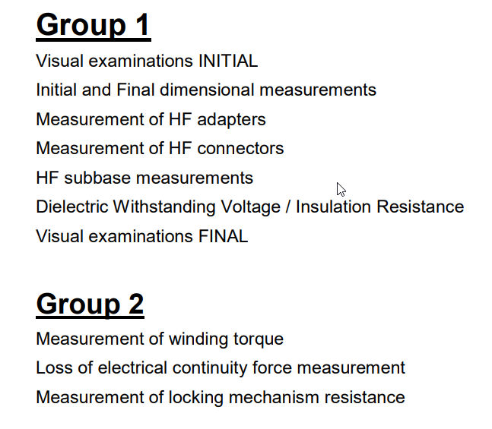
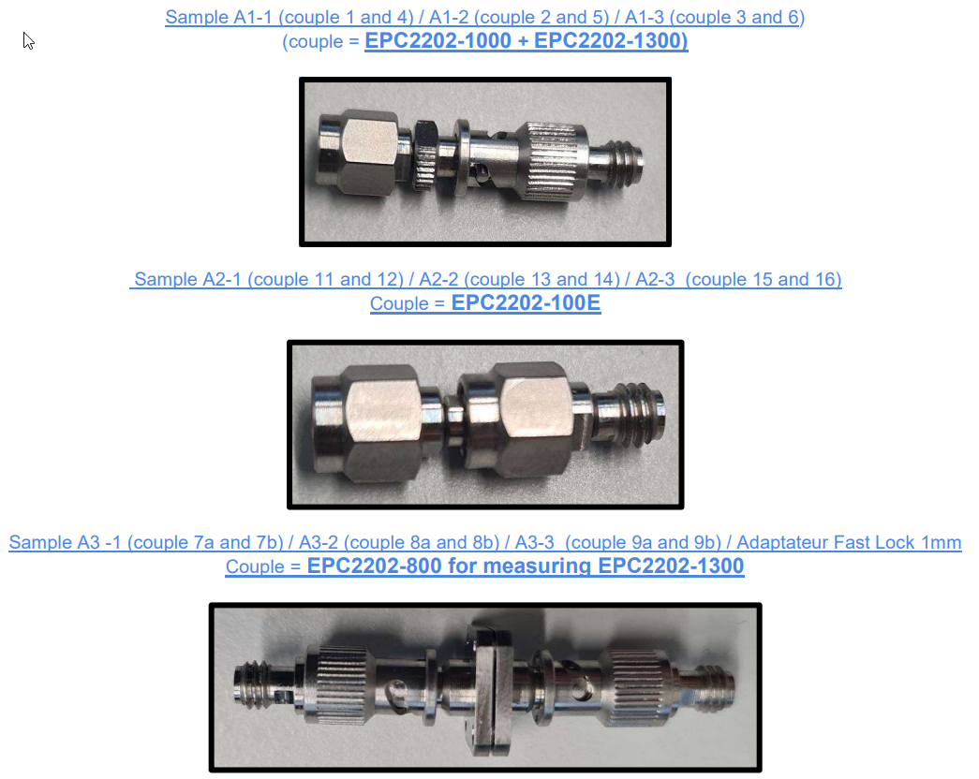
WP4: Evaluation of connectors
Full evaluations of the connector pairs. Minor anomalies identified, which should be solved during industrialization phase

Slide 24
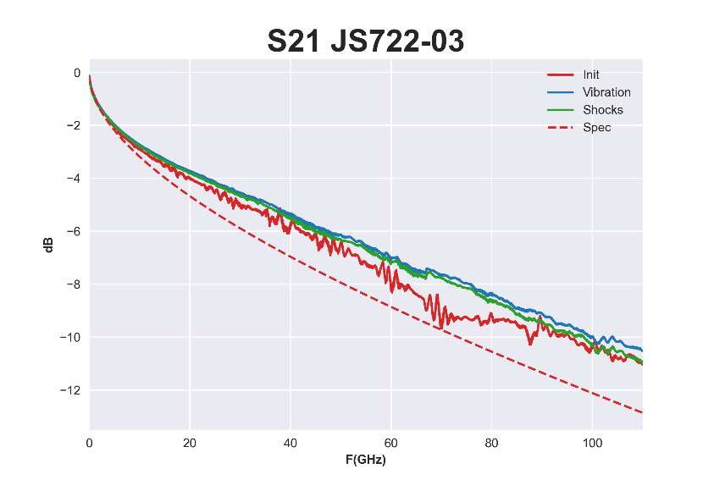
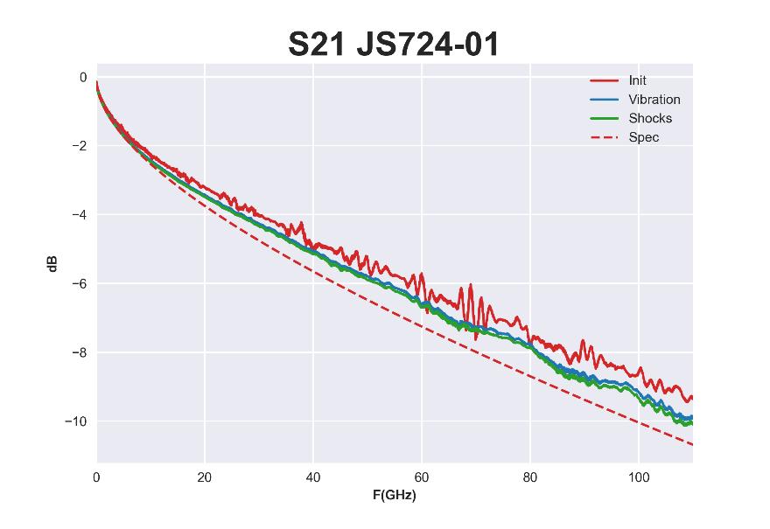
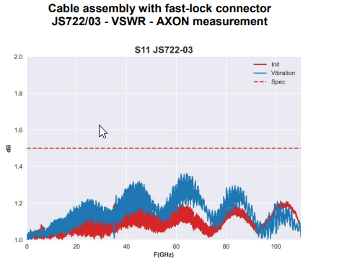
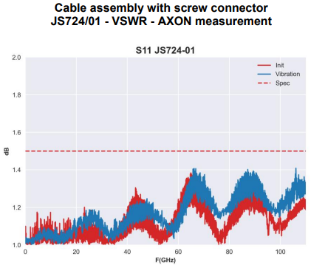
WP4 : Fast lock versus screw-in
Fast lock
Screw-in

Slide 25
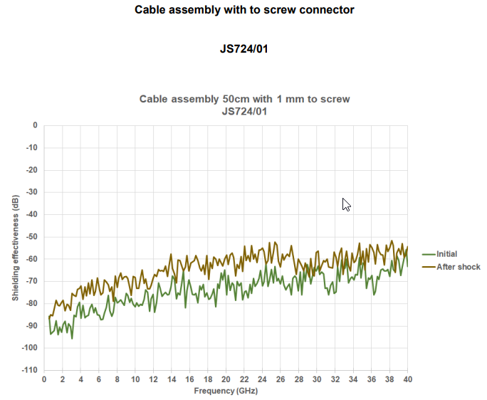
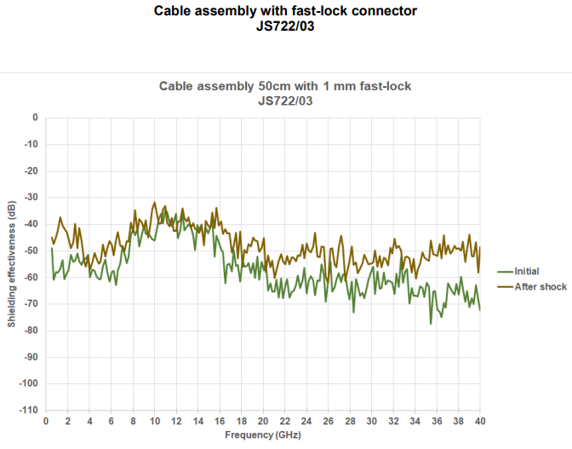
WP4 : Fast lock versus screw-in
Fast Lock
Screw-in

Slide 26
WP5: Identification of Limitations, Improvements and Impact on payload level

Slide 27
Test reviews
Cable assemblies have passed most of tests, surpassing our expectations
Cable
Presented mechanical vulnerabilities during vibration tests
Great Flexibility and tractile strength. Exceptional thermal endurance.
Connectors
Outstanding mechanical and thermal endurance
Fast lock system generates much more leakage at the interface than a screw-in system.

Slide 28
Conclusion
Coaxial solution up to 110 GHz is really feasible
To achieve TRL8
New design phase if improvement of RF leakage is required
Industrialization phase, supplier analysis for mass production capability
Based on size of market, is it relevant to get 2 different interfaces to cover same need ?
It reduces the volume and increases the costs
The time saving for integration won’t compensate the additional costs
Other markets need standardization
NEXT STEP : could be more relevant to qualify for space (go to TRL8) a 110 GHz solution with standard 1 mm interface (screw-in) !

Slide 29
THANKS for your attention
And special thanks to LEO and JOAQUIN for their support during the project
Great collaboration between RADIALL and AXON
Radiall CTA and CHR team
Richard Enquebecq, Gregory Savage, Claude Brocheton, Christophe Meynier, Fabrice Bernard, Jean-Philippe Dupont, Didier Baffert, Olivier Lefouler, Sebastien Bernardeau
Axon cable team
Lindsay Turot, Xavier Ziffel, Mohamed Benahmed, Emilien Fournaise, Stephanie Geas

